Slide 1

Analysis of World Development Indicators

Slide 2
Introduction -World Development Indicators
The World Development Indicators database contains the most comprehensive set of data on countries in the international data infrastructure.
The World Development Indicators from the World Bank contain over a thousand annual indicators of economic development from hundreds of countries around the world.
It presents the most current and accurate global development data available, and includes national, regional and global estimates.

Slide 3
The World Development Indicators data has been downloaded from https://datacatalog.worldbank.org/search/dataset/0037712
This data set contains information about World Bank project lending since 1960 to 2021 year.
The data provides an open collection of 1,442 high-quality indicators and series code.
It includes data for 180 countries, 48 Categorized territories and 7 Aggregated Regions ; with notable exception of Taiwan( going back as far as 1960)
Although, Observed Many indicators started recording after year 2000 .
Most data are not reported in annually unless for most important indicators for e.g. ‘GDP per capita growth (annual %)’ generally reported once every 2 years .
There are multiple GDP series available , for most non-specialist users, GDP per capita at current US dollar is good enough.
The countries data includes vital information regarding to population, Income and expenditure details, Currency, Region .
A detailed explanation of Indicators is maintained along with indicator codes and series code.
The series code gives the information related to periodicity , any limitations and exceptions, weblinks and license type.

Slide 4
Corruption Perception Index
The Corruption Perception Index data holds the Corruption indicator and the rank from 2012-2020.
The higher the CPI score lower is the corruption.
The higher the rank higher is the corruption
Denmark is the least corrupted country.
South Sudan and Somalia are the highest corrupted countries.
CPI2020 data consists of
The confidence interval of the score calculation
Different types are indexes and ratings are provided

Slide 5

Data Pipeline
Extract data from different sources such as:
csv files –
WDICountry, WDICountry-Series, WDIData, WDIFootNote,
WDISeries, WDISeries-Time
Excel files – CorruptionPerceptionIndex
Transform data
combining data from different sources
data cleaning
data types
Foreign keys
Checking for missing data
Checking for duplicate data
engineering features
file encodings
Load
send the transformed data to a database
Database has been created using MySql Workbench.
All the necessary tables are created with constraints.
Primary Keys

Slide 6
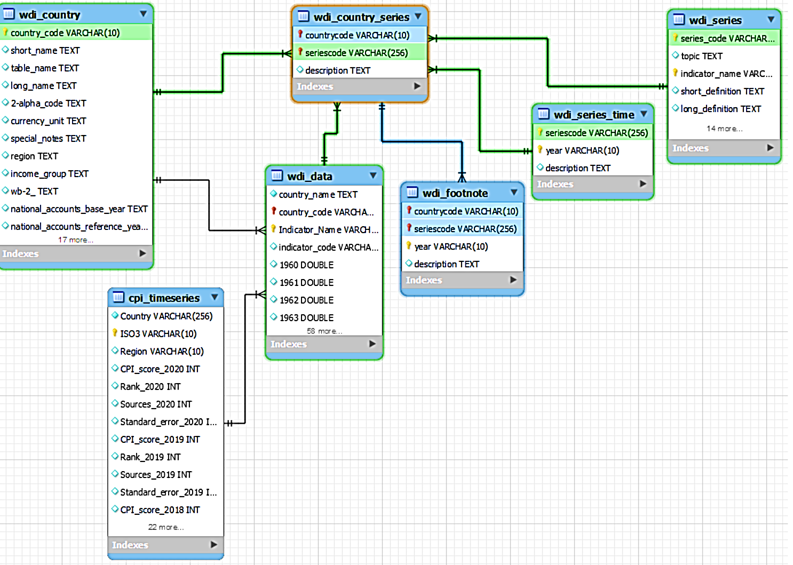
Creating Database
Logical EER Diagram

Slide 7
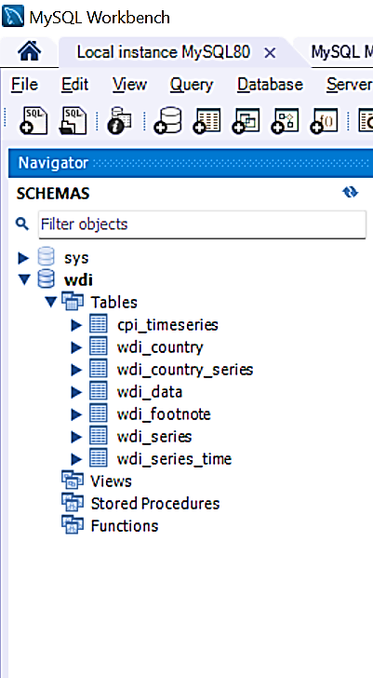
Creating Database
Schema creation

Slide 8
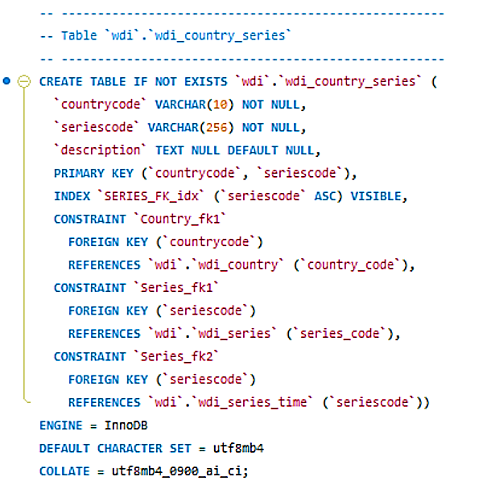
Creating Database
Tables creation along with Constraints

Slide 9
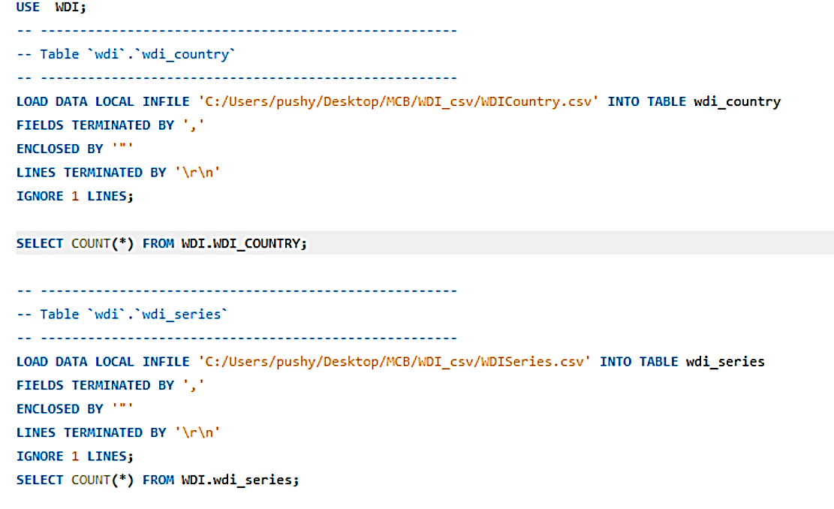
Creating Database
Loading Data

Slide 10
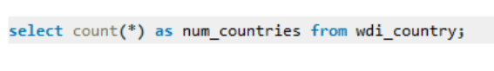
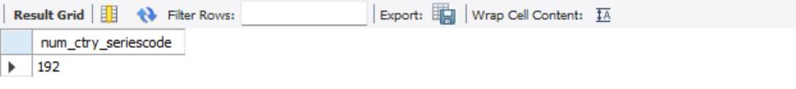
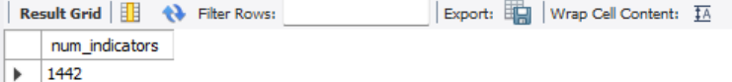
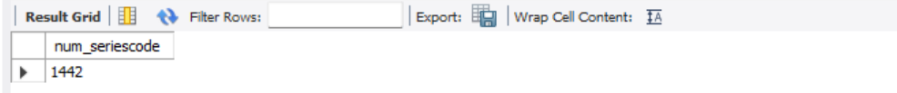
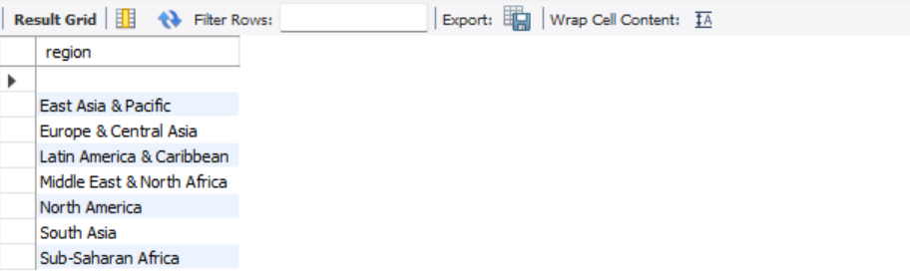
Exploratory Data Analysis

Slide 11
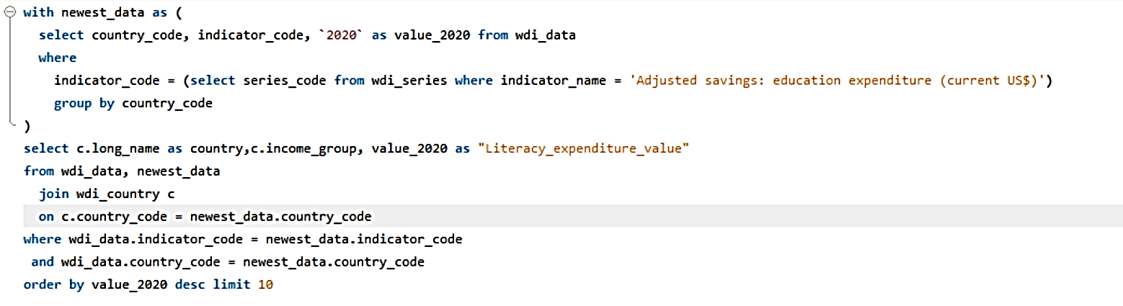
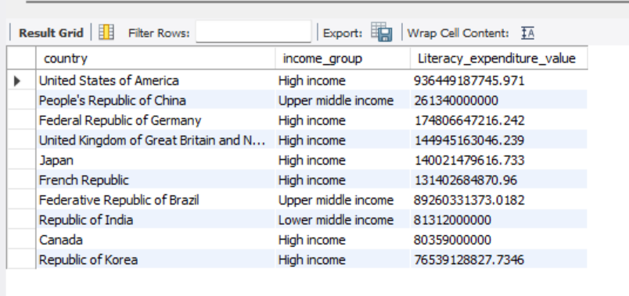
Exploratory Data Analysis

Slide 12
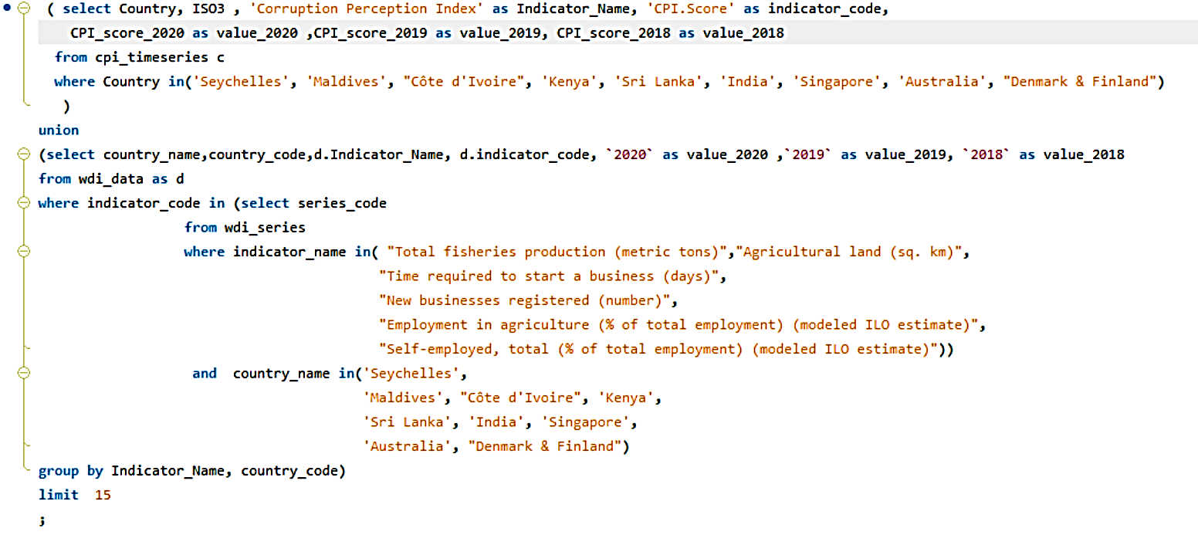
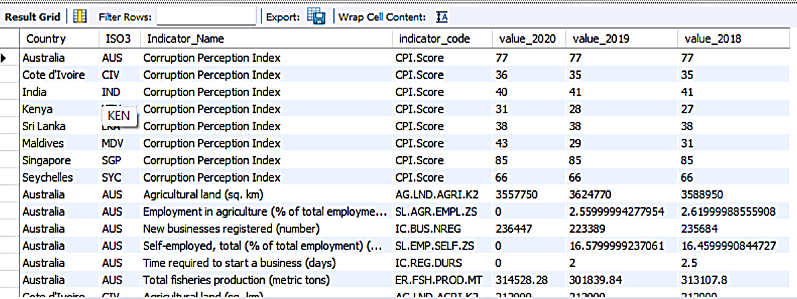
Report – list of countries & list of indicators

Slide 13
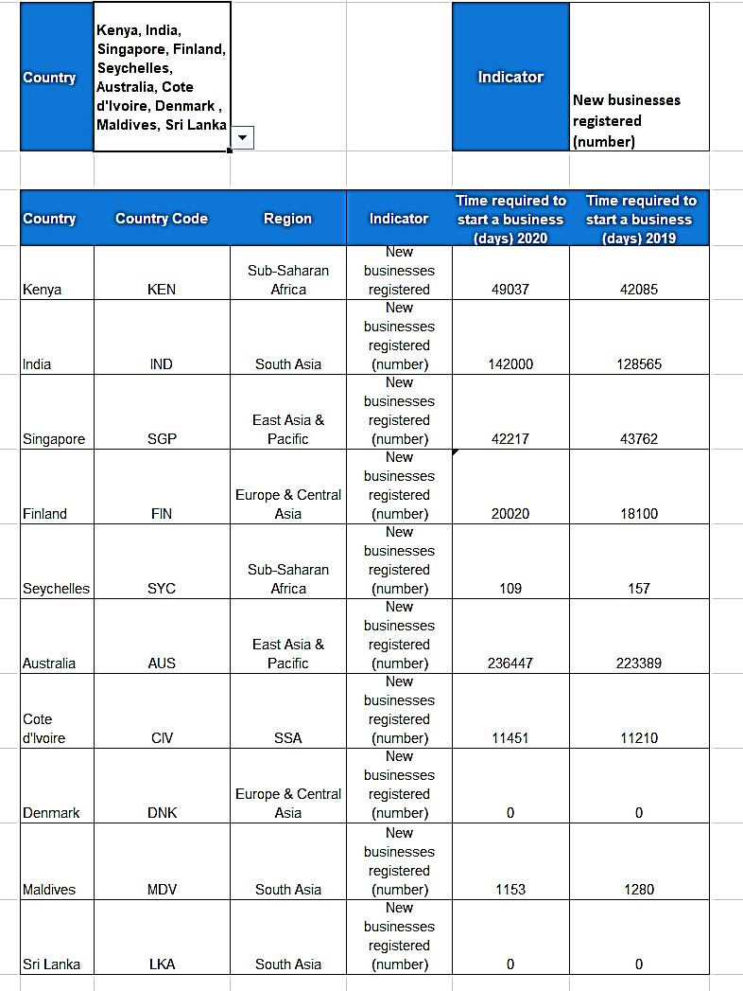
Report – list of countries & list of indicators

Slide 14
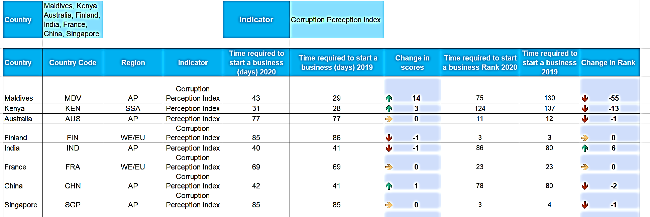
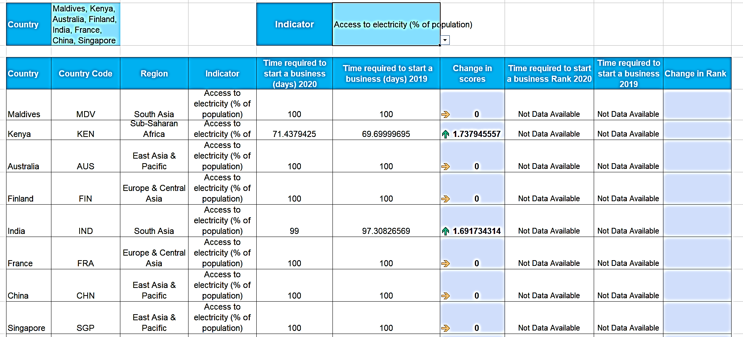
Report – list of countries & list of indicators

Slide 15
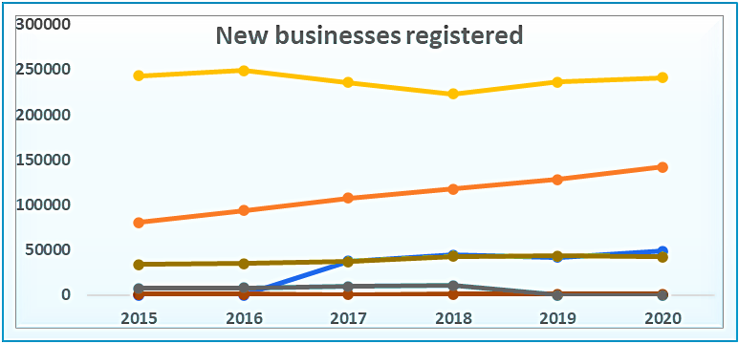
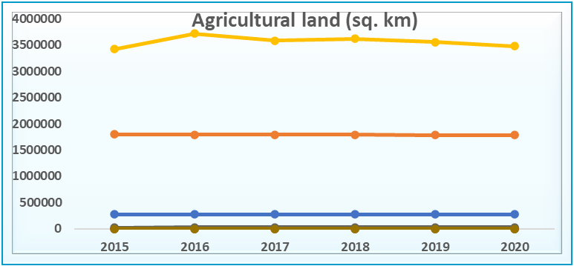
Analysis of WDI among Countries
New Businesses Registered:
Australia has highest number of business registered over the period though there is a slight fall during 2018,2019.
Followed by India, which is linearly increasing over the period.
Agricultural Land :
Australia holds the highest land under agricultural compared to other countries ,peak value in 2016 from there on the value is dropping.
Followed by India, maintaining the same proportion of land year on year.

Slide 16
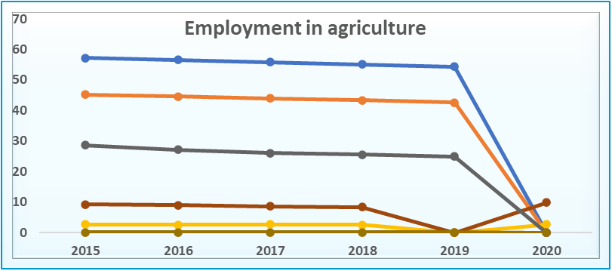
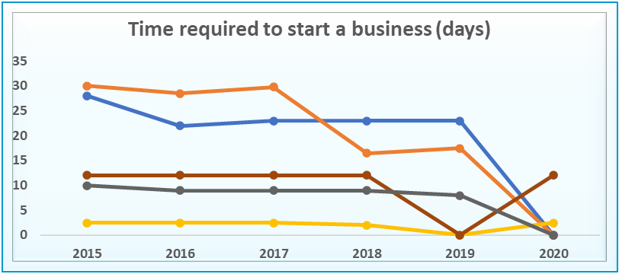
Analysis of WDI among Countries
Employment in Agriculture
Kenya has highest employment in agriculture in 2015 and there is a slight fall every year.
Followed by India, which is proportionately decreasing over the period.
In 2020 the data has not be recorded.
Time required to start new business:
In 2015 India is taking highest time to start the business followed by Kenya.
In the following years India has comparatively reduced the time to start the new business. Where as Kenya has increased the time to start the new business.
The data hasn’t been recorded for Maldives in 2019 and other countries in 2020.

Slide 17
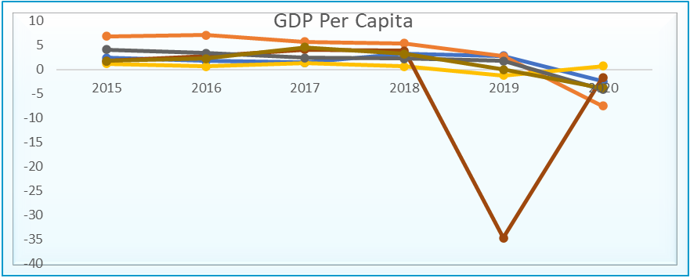
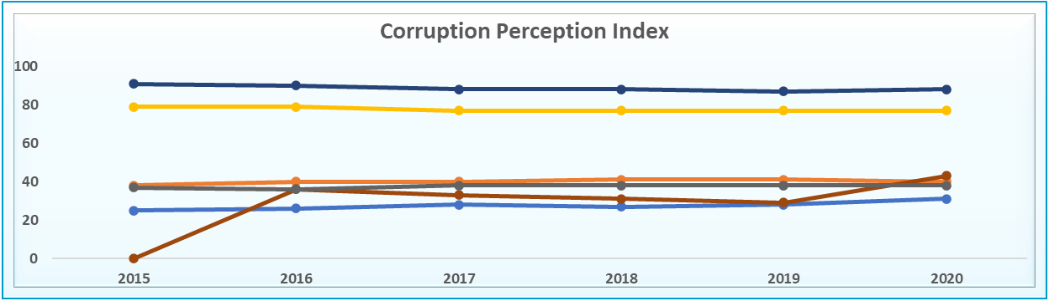
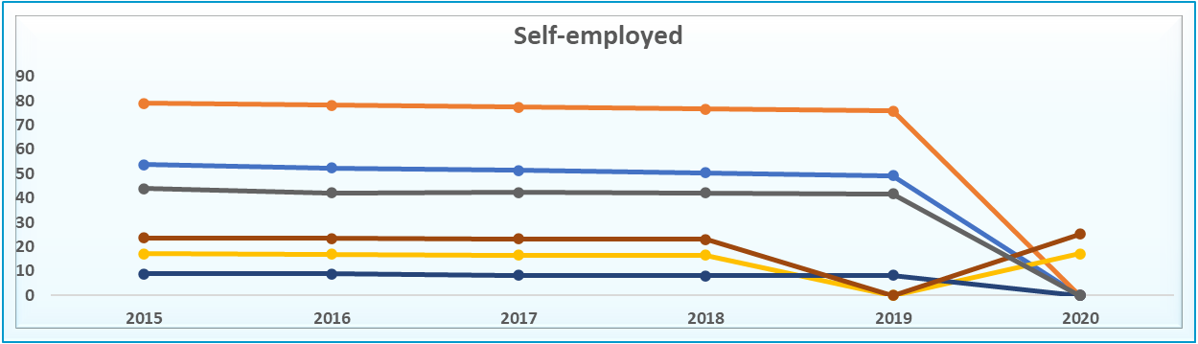
Analysis of WDI among Countries
GDP Per capita
India has highest GDP in 2015, over the period of time it is following a decreasing trend.
Maldives has highest negative in 2019, which increased comparatively better by 2020.
All the countries has a dip in 2019.
Corruption Perception Index:
In 2015 Maldives has lowest perception index which indicates it has highest corruption, which slowly improved over time except for 2019.
Rest of the countries are able to maintain a steady corruption perception index over the period.
Self-Employed:
In 2019, the data has not been recorded for Maldives, Australia.
In 2020 except for Australia , the data hasn’t been recorded for other countries.
The average score of self employed indicator has been maintained in all the years.

Slide 18
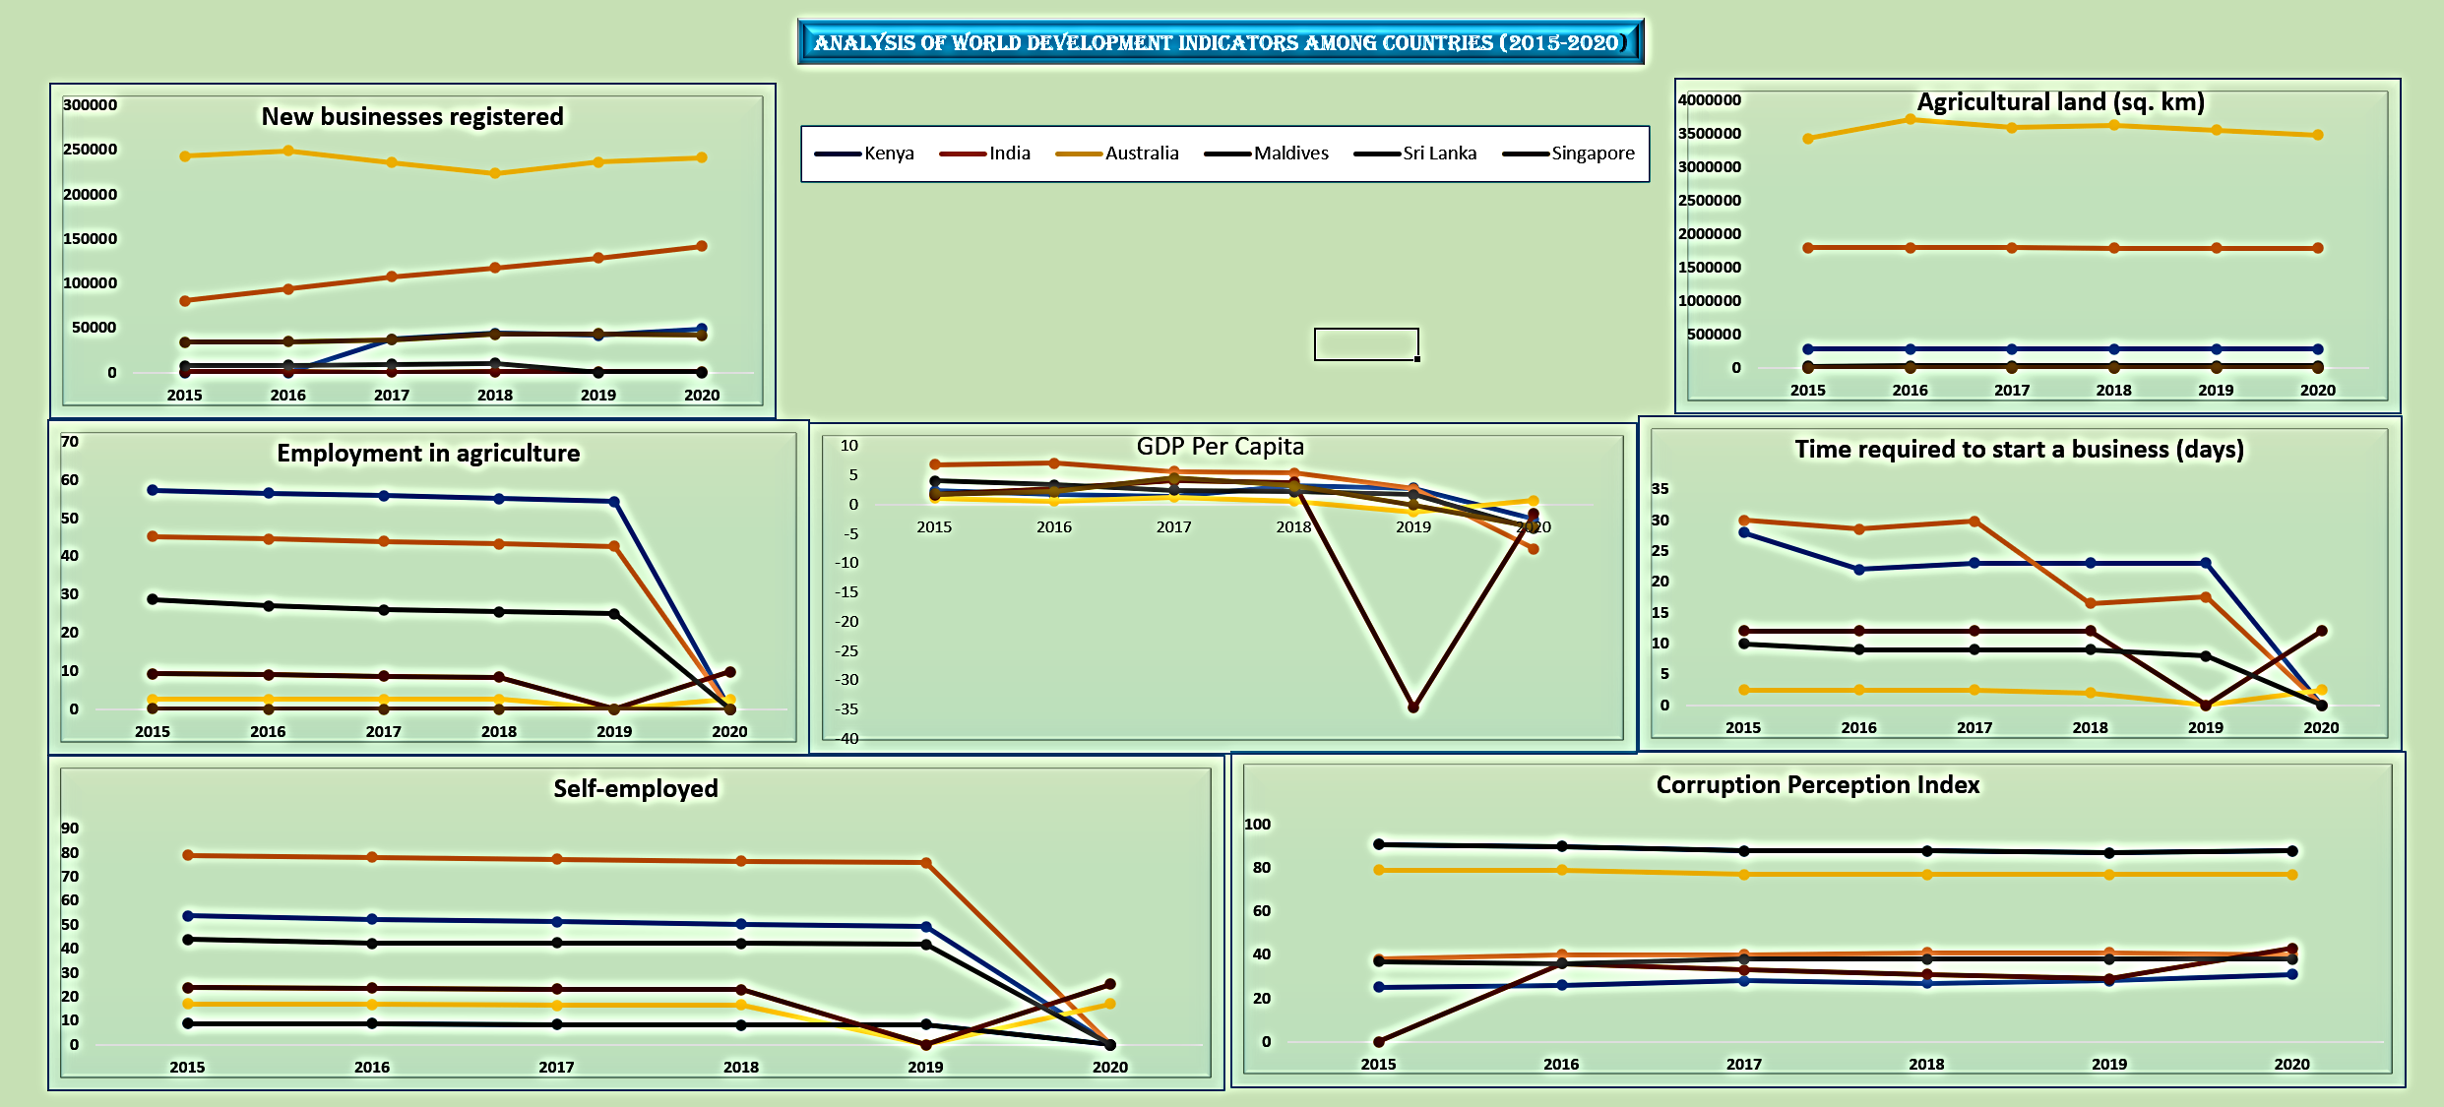
Analysis of WDI among Countries(2015-2020)

Slide 19
GitHub Repository
Please find the SQL Queries for the database creation :
https://github.com/pushyamikeerthi/World-Development-Indicators

